Slide 1


UNLOCKING THE POTENTIAL OF INTEGRATED RESOURCE MANAGEMENT: A HOLISTIC APPROACH TO WATER, WASTE, ENERGY, AND MATERIALS
Dr Fabiana Tessele
Tessele Consultants
Notes:
A holistic perspective on the interdependency of water, waste, energy and materials, and how they can positively impact each other.
Circular economy framework enabling integrated resource recovery
Will focus on how the water utilities could be driving this integration for several reasons
Will present some examples of best practises and what we could be doing better in this space
Sharing my experience across industries, globally

Slide 2
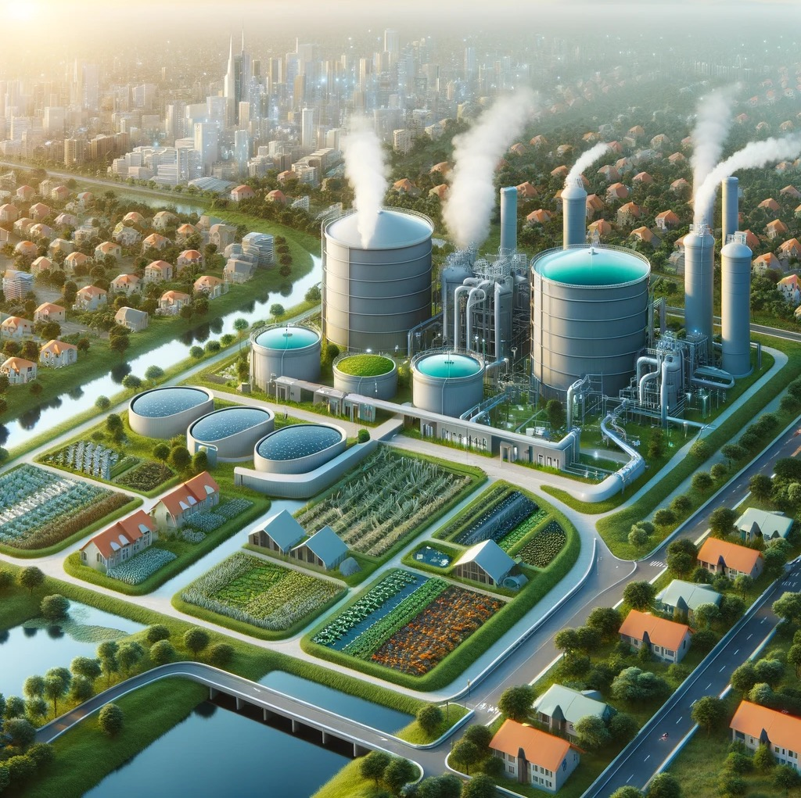
Integrative Water Utility
Water utilities can drive circular economy integration, linking energy and industry sectors.
Energy-efficient practices reduce water utilities' carbon footprint, enhancing sustainability.
Industrial symbiosis facilitated by water utilities minimises waste and optimises resource use.
Collaborative resource exchange with industries fosters circularity, reducing environmental impact.
Supportive policies and incentives are vital to leverage water utilities as circular economy connectors.
Notes:
Water utilities are a key player in closing the loops:
- technical capability
Corporate objectives (carbon neutrality)
Regional presence and knowledge
Proximity to stakeholders as the water supplier/wastewater treatment provider
Financial capacity for funding the projects
Community outreach to communicate/engage the various stakeholders

Slide 3
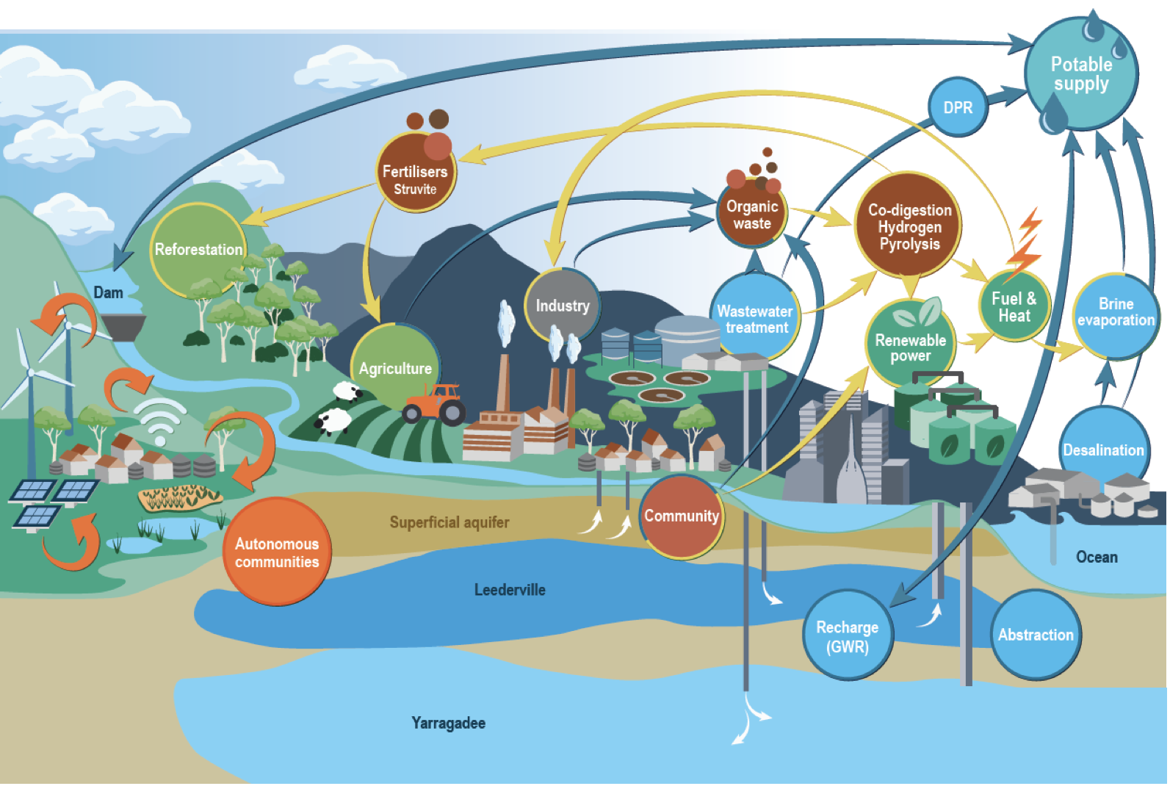
Notes:
5 years ago- developed the vision based in Perth case
Start from the Integrated water supply scheme, groundwater, dams, desalination and indirect potable reuse
Recovery of biogas from the wastewater – not only form sludge/organic wastes
The economy of scale by incorporating Industrial streams
Production of valuable fertilisers/soil conditioners that can be combined reducing the reliance on chemical fertilisers, lower carbon footprint
All wastewater should be used for irrigation and other non-potable uses
Decentralised + connected – case study later in the preso

Slide 4

Water Utilities as Drivers of Circular Economy
Water utilities can be the nexus of circularity, facilitating the flow of resources between sectors.
Wastewater treatment plants supply biogas to the energy sector and reclaimed water for industrial processes.
Water utilities are key in closing the loop of resource use.
Notes:
Water utilities are already doing parts of it, isolated initiatives
The next step can be a more holistic approach, connecting the various streams
Fostering economic growth, smaller players can be part of the bigger picture
Kwinana synergies is an example that can be leveraged on

Slide 5
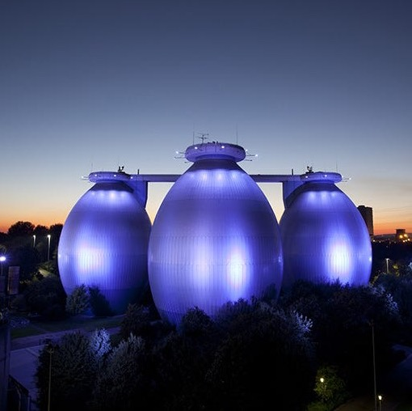
Enhancing Sustainability through Efficiency
Implement energy-efficient practices in water treatment and distribution.
Impact statistics: Lower energy consumption leads to reduced greenhouse gas emissions.
Case studies to follow
Notes:
Break the barrier between water and energy
Refer to Woodman Point energy recovery from sludges, could be much more efficient if there was a co-digestion project associated (fogo, industrial, etc)
Link desalination and biogas: combined power and water generation, utilising the excess heat from gas turbines, using water production as a battery
Example of Dubai Electricity & Water Authority (DEWA)
Mention the following examples

Slide 6
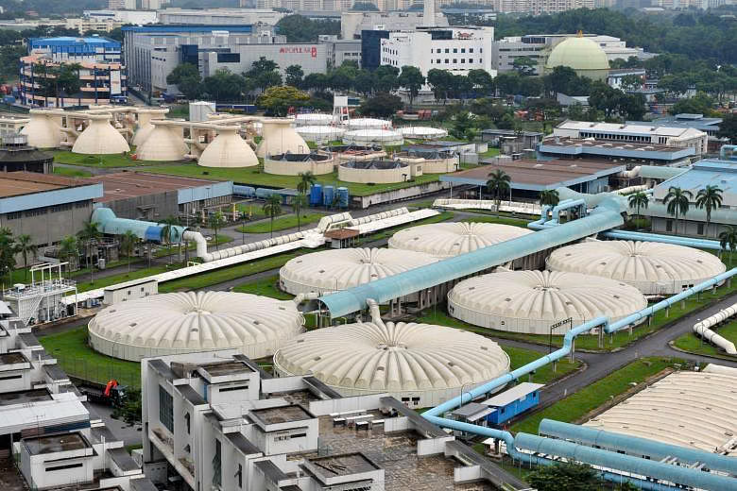
Public Utilities Board
Highlights
Tuas Nexus is a hallmark of sustainability, leveraging the symbiotic potential of the Water-Energy-Waste Nexus for a resilient future
Innovation in Energy: PUB's breakthrough in co-digesting food waste with used water sludge amplifies biogas production.
Strategic Infrastructure: The IWMF and Tuas WRP, crucial components of the DTSS Phase 2, are set to be completed in 2025.
Sustainable Synergies: The integration at Tuas Nexus is a strategic move towards maximizing energy and resource recovery, positioning Singapore at the forefront of sustainability efforts.
Environmental Stewardship: This initiative is a testament to Singapore's commitment to minimising its environmental footprint through smart, integrated waste management.
Notes:
Singapore has a strong focus on co-digestion and economy of scale, in urban area
Very well planned to prevent emissions
Pioneering in this region

Slide 7
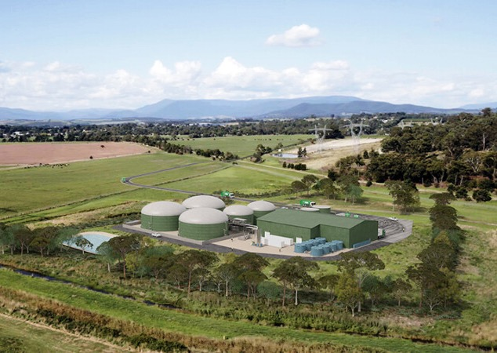
Yarra Valley Water
Renewable Pledge: Committed to self-generating all required energy through renewable sources by 2025.
Environmental Stewardship: Ensuring service delivery while preserving the water necessary for thriving waterways.
Circular Economy: Incorporating circular economy principles to enhance operational sustainability.
SDG Alignment: Addressing multiple Sustainable Development Goals (SDG30) through eco-conscious practices.
Notes:
- Mention Joe’s speech earlier
- Very good example, still not fully integrated
- Victoria just launched the Guidelines for the safe production and use of digestate, pioneering the regulators in Australia - hoping the other states will catch up

Slide 8
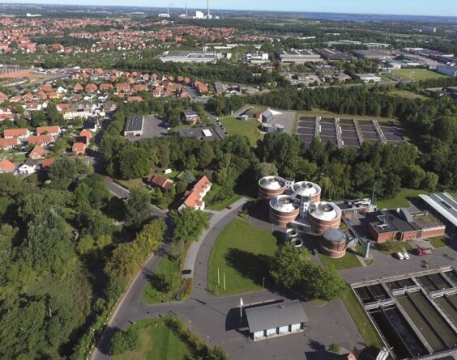
VCS Denmark
Energy Storage in Reservoirs: Utilizing water reservoirs for energy storage, aiding the grid during peak demand.
Smart Grid Integration: Direct connection to the energy grid to supply power when it's needed most.
WISE Software: Advanced control with Sweco's WISE system for water production optimisation.
Energy Price Forecasting: Intelligent planning of water treatment based on energy market trends, enhancing SCADA systems.
Notes:
A very good example of Integrated decentralisation
Smart use of energy, using water reservoirs for energy storage
Smart grid integration
AI to predict peak demands/prices
Results in operational cost savings and energy efficiency, plus lean infrastructure
Another example is Svensk Biogas, near Stockholm, they fuel their local fleet with biomethane (180 buses, 3000 cars, 25 trucks)

Slide 9

Regulation Driving Innovation
France's Biomethane Ambition
Targeting 8 TWh/year of biomethane in the public grid by 2025.
Current use is predominantly for vehicle fuel; with potential growth in domestic heating.
Enabling diverse valorisation pathways, is beneficial for decentralized projects, especially in the food industry.
UAE's Zero Discharge Directive
Bans direct discharge of effluents in the UAE, enforcing total treatment and reuse.
Positions treated wastewater as a commercial asset, promoting sustainable practices.
Brazil's PROSAB Initiative
Federally funded sanitation research enhancing services in underprivileged areas.
University-led R&D fostering social impact and skill development for local water and sanitation.
Notes:
Go through the regulations:
France biomethane injection
UAE zero discharge policy – greening the desert, increased rainfall
Prosab, PHD students providing innovative solutions to smaller urban centres, interacting with operators to improve efficiencies in nature-based technologies, and anaerobic processes
Add the case of Breweries in WA, where the regulator could be a game-changer
DPIRD developing the code of practice
Small scale, with High carbon stream derived from brewing activities, considered as hazardous waste (it’s beer!!), and needs special permit to transport
Can be used as a carbon source for BNR processes in other industries, such as the red meat processors
Very good substrate for AD plant, but normally not enough scale for stand alone digesters
Regulator is limiting regional growth by not shifting the paradigm

Slide 10

Industrial Symbiosis and Collaborative Circularity
Water utilities can minimise waste through collaborative practices.
Examples of resource optimisation: Recycling industrial wastewater and supplying recycled water.
Foster collaborative efforts with industries to enhance circularity and reduce environmental impacts.
Notes:
Mention the case of Kwinana water recycling and Sydney water
Live export ban, the red meat industry needs to increase capacity, limited by wastewater disposal
Local water utilities could benefit from the energy, nutrients and non-potable water, unlocking economic growth in regional areas
Harvey Water and Harvey Fresh, augmentation of non-potable supply in Harvey DAM
Work in alternative collaborative business models, co-funding between private and public sector

Slide 11

Policy Frameworks for Circular Economy
Need for supportive legislation and financial incentives to promote circular economy initiatives.
Role of government and regulatory bodies in enabling water utilities to become circular economy connectors.
Call-to-action for stakeholders to engage in policy advocacy for sustainable resource management.
Notes:
We need the regulator to take leadership and drive change, instead of pulling the breaks
Better community education, reduce resistance

Slide 12

Leveraging Decentralisation for Circular Efficiency
Resilience: Smaller, interconnected systems enhance stability and reduce systemic risks.
Efficiency: Local recycling and treatment align with specific industrial needs, saving energy.
Community & Economy: Encourages local job growth and resource stewardship.
Agility: Quickly adapts to changing resource needs and availability.
Policy Role: Critical for enabling decentralised, circular models.
Decentralisation can lead to significant energy and waste reductions, fostering economic and environmental sustainability.
Notes:
Stronger regions, attracting and retaining talents, tailor-made for the local community needs

Slide 13

Final Remarks

Slide 14

Hands-on workshop
We will explore the case study based on Bunbury's real numbers, including quantifying the resources that could be recovered!
Join us at 4pm
Session 19 M1-M3

